Slide 1


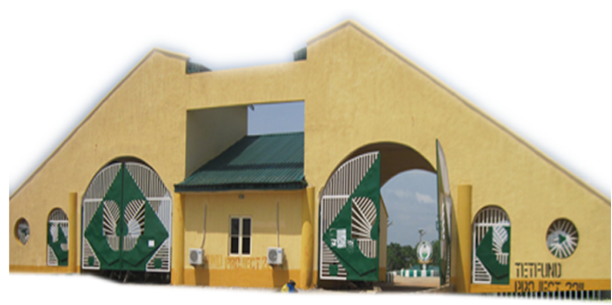
MECHANICS OF MACHINES
MEE 203: APPLIED MECHANICS
MEE 203 Applied Mechanics
Federal University Oye-Ekiti
MECHANICS OF MACHINES II
(TME 411)
Dr. David Fadare
Course Lecturers: Dr. David A. Fadare & Enrg. O.C. Okoye

Slide 2
Aim of the course
The course is aims at equipping the students with basic engineering knowledge and skill required of any sound engineer in solving real life problems associated with mechanics of engineering systems
MEE 203 Applied Mechanics
Federal University Oye-Ekiti

Slide 3
COURSE OUTLINE
MEE203 Applied Mechanics (3 Units) Status (Compulsory)
Part I: Statics (Dr. David A. Fadare)
Principles of mechanics. Forces, Moment Couples, Laws of Mechanics. Coplanar forces and their resultants. First and Second Moments of area. Centroids. Distributed line loads and their resultants. Application of vectors to resolution of forces. Equilibrium of particles. Free body diagrams, friction.
Part II: Dynamics (Engr. O.C. Okoye)
Kinematics of particles and rigid body kinematics in plane motion. Application of Newton’s laws of motion. Rigid body translation, rotation about fixed axis and the velocity and acceleration of general plane motion. Relative motion of two particles. Dependent motion of particles. Instantaneous centre of rotation. Kinetics of particles, kinetic energy; principles of work and energy, impulse and momentum analysis, moment of inertia, Simple harmonic motions.
MEE 203 Applied Mechanics
Federal University Oye-Ekiti

Slide 4
Selected Bibliography:
Engineering Mechanics – Statics by A. Bedford and W.Fowler, Addison Wesley Longman (1996) ISBN 0-201-40340-4.
A textbook of Engineering Mechanics, 20th revised Edition by R.S. Khurmi
Applied mechanics and strength of materials by R.S. khurmi
Engineering mechanics Dynamics by Gary L. Gray, Francesco Costanzo & Michael E. Plesha
MEE 203 Applied Mechanics
Federal University Oye-Ekiti

Slide 5
Introduction to Engineering Mechanics
Engineering Mechanics is the branch of Applied Science, which deals with the laws and principles of Mechanics, along with their applications to engineering problems.
The knowledge of Engineering mechanics is very central in the training of Engineers. It is essential for an Engineer in planning, designing and construction of various types of structures and machines.
MEE 203 Applied Mechanics
Federal University Oye-Ekiti

Slide 6
Division of Engineering Mechanics
The subject of Engineering Mechanics may divided into the following two main group:
Static
Dynamics
MEE 203 Applied Mechanics
Federal University Oye-Ekiti

Slide 7
STATICS
It is the branch of Engineering Mechanics, which deals with the forces and their effects, while acting upon the bodies at REST
MEE 203 Applied Mechanics
Federal University Oye-Ekiti

Slide 8
DYNAMICS
It is the branch of Engineering Mechanics, which deals with the forces and their effects, while acting upon bodies in MOTION.
Dynamics may be further sub-divided into the following two branches:
Kinetics
Kinematics
MEE 203 Applied Mechanics
Federal University Oye-Ekiti

Slide 9
Branches of Dynamics
KINETICS: It is the branch of Dynamics, which deals with the bodies in motion due to the application of forces.
KINEMATICS: It is the branch of Dynamics, which deals with the bodies in motion, without any reference to the force which are responsible for the motion.
MEE 203 Applied Mechanics
Federal University Oye-Ekiti

Slide 10
Lecture I: System of Forces
Learning Outcome:
On completion of this lecture the student is expected to be able to:
Determine forces acting on objects using
the concepts of equilibrium and free-body diagrams for two and three dimensional force systems
MEE 203 Applied Mechanics
Federal University Oye-Ekiti

Slide 11
System of forces
Force is an important factor in the field of Mechanics.
A force is defined as an agent which produces or tends to produce, destroys or tends to destroy motion.
When two or more forces act on a body, they are said to form a system of forces
MEE 203 Applied Mechanics
Federal University Oye-Ekiti

Slide 12
Effects of a Force
A force may produce the following effects in a body on which it acts:
It may change the motion of a body, i.e. if the body is at rest, the force may set it in motion and if already in motion, the force may accelerate it.
It may retard the motion of a body.
It mat retard the forces already acting on a body thus bringing it to rest or in equilibrium.
It may give rise to internal stresses in the body, on which it acts.
MEE 203 Applied Mechanics
Federal University Oye-Ekiti

Slide 13
Characteristics of a Force
In order to determine the effects of a force in a body, we must know the following:
Magnitude of the force (100N, 200N, etc)
The direction of the line of action (along OX)
Nature of the force (i.e. push, pull or lift). This is indicated by placing arrow head on the line of action of the force.
The point at which (or through which) the force acts on the body.

Slide 14
Principle of Physical Independence of Forces
It states, “If a number of forces are simultaneously acting on a particle, then the resultant of these forces will have the same effect as produced by all the forces’’
MEE 203 Applied Mechanics
Federal University Oye-Ekiti

Slide 15
Principle of Transmissibility of Forces
It states, ‘’If a force acts at any point on a rigid body, it may also be considered to act at any other point on its line of action, provided this point is rigidly connected with the body”
MEE 203 Applied Mechanics
Federal University Oye-Ekiti

Slide 16
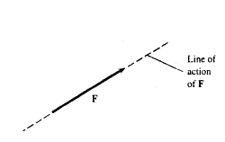
Line of Action of a Force
The straight line collinear with the force vector is called the ‘line of action’ .
MEE 203 Applied Mechanics
Federal University Oye-Ekiti

Slide 17
Types of System of Forces
Coplanar forces: The forces, whose lines of action lie on the same plane.
Collinear forces: The forces, whose lines of action lie on same line.
Concurrent forces: The forces, which meet at a point.
Coplanar concurrent forces: The forces, which meet at a point and their lines of action also lie on the same plane.
MEE 203 Applied Mechanics
Federal University Oye-Ekiti

Slide 18
Types of System of Forces Cont…
Coplanar non-concurrent forces: The forces, which do not meet at one point, but their lines of action lie on the same plane.
Non-coplanar concurrent forces: The forces, which meet at a point, but their lines of action do not lie on the same plane.
Non-coplanar non-concurrent forces: The force, which do not meet at a point and their lines of action do not lie on the same plane.
MEE 203 Applied Mechanics
Federal University Oye-Ekiti

Slide 19
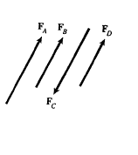
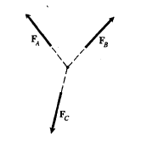
Types of System of Forces
Coplanar Non-concurrent Forces
Coplanar Concurrent Forces
MEE 203 Applied Mechanics
Federal University Oye-Ekiti

Slide 20
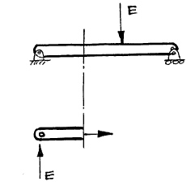
External and Internal Forces
A given object is subjected to an external force if the force is exerted by a different object. If an object is subjected to a force by another part of the same object, the force is termed an internal force.
E – External Force
I – Internal Force

Slide 21
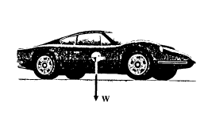
Gravitational Forces
Force exerted on an object by the earth’s gravity.
W = mg
Where: W = weight (N)
m = mass (kg)
g = acceleration due to gravity
W = 9.81 m/s2

Slide 22
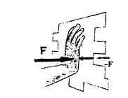
Contact Forces
Forces that result from contacts between objects.
Force vector F represents the force exerted on the wall. The wall exerts a force –F on the hand.
Newton’s law: Forces exerted on each other by any two particles are equal in magnitude and opposite in direction.
MEE 203 Applied Mechanics
Federal University Oye-Ekiti

Slide 23
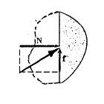
Surface Forces
Consider two plane surfaces in contact.
The force F is exerted on the bottom surface. The force F resolved into two components, normal (N) and parallel (f) to the surface.
MEE 203 Applied Mechanics
Federal University Oye-Ekiti

Slide 24
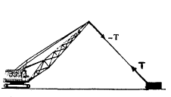
Ropes and Cables
A contact force can be exerted on an object by attaching a rope or cable to the object and pulling it.
The force T (tension) is exerted on the container by the cable.
The force –T (equal and opposite force) is exerted on the crane by the cable.
MEE 203 Applied Mechanics
Federal University Oye-Ekiti

Slide 25
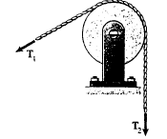
Pulley System
A pulley changes the direction of a rope or cable. When the pulley can turn freely, and the rope or cable either is stationary or turns the pulley at a constant rate:
T1 = T2
MEE 203 Applied Mechanics
Federal University Oye-Ekiti

Slide 26
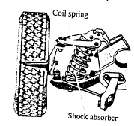



Springs System
Springs are used to exert contact forces in mechanical devices. For example in a car suspension system.
In tension
A spring of unstretched length LO. The spring stretched to a length L > LO. The force F exerted by the spring and the force –F on the spring.
MEE 203 Applied Mechanics
Federal University Oye-Ekiti

Slide 27



Spring System in Compression
A spring of length LO. The spring compressed to a length L < LO. The spring pushes on an object with a force F and the object exerts a force –F on the spring.
MEE 203 Applied Mechanics
Federal University Oye-Ekiti

Slide 28
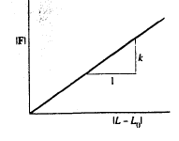
Magnitude of Spring Force
Force is a linear function of the change in length, k(N/m) termed spring constant equals the magnitude of force required to stretch or compress the spring a unit of length.
MEE 203 Applied Mechanics
Federal University Oye-Ekiti

Slide 29
Example
LO = 1m
k = 3000 N/m
L = 1.2 m
The magnitude of the pull it exerts is:
K ( L – LO ) = 3000 ( 1.2 – 1 )
= 600
MEE 203 Applied Mechanics
Federal University Oye-Ekiti

Slide 30
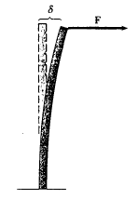

Modelling of Engineering systems with string
Springs can be used to model a system in which forces depend on displacements.
The force required to bend the steel beam is a linear function of displacement d .
F = k d
Complicated structures can be analysed by modelling them as assemblages of small elements connected by linear springs.
MEE 203 Applied Mechanics
Federal University Oye-Ekiti

Slide 31
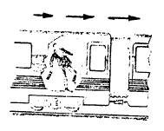
Equilibrium
Equilibrium is a state of balance.
While the train moves at a constant speed, a person standing in the aisle is in equilibrium. If the train starts to speed up, the person is no longer in equilibrium.
The vector sum of the external forces acting on an object in equilibrium is zero:
ΣF(x,y,z) = 0
MEE 203 Applied Mechanics
Federal University Oye-Ekiti

Slide 32

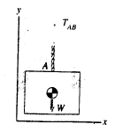
Free-Body Diagram (FBD)
FBD is a drawing of an object and the external forces acting on it.
To determine the tension in cable AB of the stationary block:
Isolate the lower block and part of cable AB.
Introduce a coordinate system.
Indicate the external forces on the free-body diagram.
Since FBD is in equilibrium:
ΣFy = TABy – Wy = 0
= (TAB – W)y = 0
Cable tension TAB = W
MEE 203 Applied Mechanics
Federal University Oye-Ekiti

Slide 33
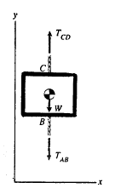
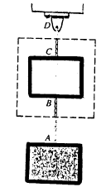
To determine the tension in cable CD:
ΣF = TCD y – TAB y -W = 0
= (TCD – TAB - W ) y = 0
Since TAB = W
TCD = 2W
MEE 203 Applied Mechanics
Federal University Oye-Ekiti

Slide 34
Two-Dimensional Force System
Consider a two-dimensional (coplanar) system of forces acting on an object in equilibrium. Choose a coordinate system so that the forces lie in the x-y plane.
ΣF = (ΣFx) i + (ΣFy) j = 0
where ΣFx and ΣFy are the sums of the x and y components of the forces. It is satisfied if :
ΣFx = 0 , ΣFy = 0
Obtain two equilibrium equations.
MEE 203 Applied Mechanics
Federal University Oye-Ekiti

Slide 35
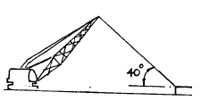
Worked Example
The cable of a crane is attached to a stationary container of mass 300 kg. The tension in the cable is 1 kN. Determine the normal and friction forces exerted on the container by the ground.
MEE 203 Applied Mechanics
Federal University Oye-Ekiti

Slide 36
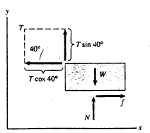
Solution
Free-body diagram shows known and unknown forces.
W = mg
= 300 x 9.81 = 2943 N
T = 1000 kN
Introduce a coordinate system and resolve T into components.
Apply the equilibrium equations:
ΣFx = 0 :
ΣFx = f – T cos 40 = 0
ΣFy = 0 :
ΣFy = T sin 40 + N – W = 0
Friction force f = T cos 40
= 1000 cos 40 = 766 N
Normal force N = W – T sin 40
= 2943 – 1000 sin 40
= 2300 N = 2.3 kN
MEE 203 Applied Mechanics
Federal University Oye-Ekiti

Slide 37
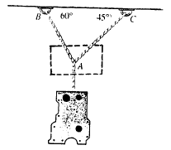
Worked Example
A car engine block is suspended by a system of cables. The mass of the block is 200 kg. What are the tensions in cables AB and AC?

Slide 38
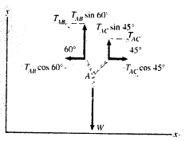
SOLUTION
Isolate part of the cable system and draw the free body diagram. Select a coordinate system and resolve the forces into components.
Apply the equilibrium equations:
ΣFx = 0 :
ΣFx = TAC cos 45 - TAB cos 60 = 0
ΣFy = 0 :
ΣFy = TAC sin 45 + TAB sin 60 – 1962 =0
Solving these equations,
TAB = 1436 N
TAC = 1016 N

Slide 39
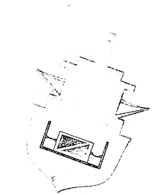
Worked Example
The 1 kN packing crate is held in place in the hold of a ship by an elastic cord on the left side of the crate. The slack cord on the right side of the crate exerts negligible force. The cord behaves like a linear spring with a spring constant k = 3 kN/m and its unstretched length is 1.5m. Neglectling friction, determine:
(a) the tension in the cord.
(b) the normal force exerted on the crate by the floor of the hold.
(c) the length of the stretched cord.

Slide 40
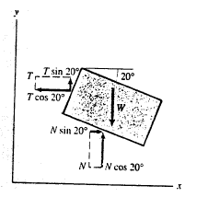
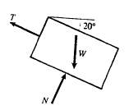
Solution 1
Isolate the crate from its surroundings and complete the free- body diagram.
W = weight, T = force exerted by the cord and
N = Normal force exerted by the floor.
Choose the coordinate system aligned horizontally and vertically.
Resolve T and N into x and y components.

Slide 41
Apply the equilibrium equations.
ΣFx = N sin 20 – T cos 20 = 0
ΣFy = N cos 20 + T sin 20 – W = 0
Solving the above equations,
N = W cos 20 = (1) cos 20 = 940 N
and
T = 342 N

Slide 42
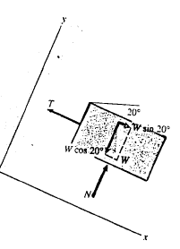
Solution 2
Align the coordinate system parallel and perpendicular to the floor.
Resolve the weight W into x and y components.
Apply the equilibrium equations.
ΣFx = W sin 20 - T = 0
ΣFy = N - W cos 20 = 0
Solving the above equations,
N = W cos 20 = 940 N
and
T = W sin 20 = 342 N

Slide 43
The tension in the cord is related to its length by
T = k (L – LO)
Where L = stretched length
LO = unstretched length
Solving the equation,
L = LO + T/k = 1.5 + 342/3000
= 1.614 m

Slide 44
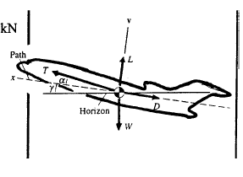
Worked Example
Figure shows the forces acting on an aircraft during a steady flight. W is the weight of the aircraft, T is the thrust exerted by its engines, L (lift) and D (drag) are the aerodynamic forces. The aerodynamic forces are resolved into components as shown. The angle γ is the flight path angle and α is the angle of attack.
If the mass of the aircraft is 72 x 10^6 g, D = 125 kN, L = 680 kN and γ = 6, determine:
(a) the thrust ;
(b) the angle of attack ;
to maintain a steady flight.

Slide 45
Solution
For the chosen coordinate system, the equilibrium
equations are:
ΣFx = T cos α – D - W sin γ = 0
ΣFy = T sin α + L – W cos γ = 0
Solving the above equations,
tan a = sin α / cos α
= (W cos γ - L) / (W sin γ + D)
= (72 x 10^3 x 9.81 cos 6 – 680 x 10^3) /
(72 x 10^3 x 9.81 sin 6 + 125 x 10^3)
α = 6.44

Slide 46
and
Thrust, T = (W sin γ + D) / cos α
= (72 x 10^3 x 9.81 sin 6 + 125 x 10^3) /
cos 6.44
= 200.1 kN
The thrust required for steady flight is 28% of the weight of the aircraft.

Slide 47
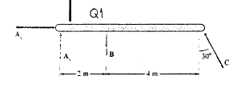
TUTORIAL
(Q1)
The beam is in equilibrium. If B = 260 N and C = 100 N, determine the forces Ax and Ay .

